Slide 1


Girl Scout Juliettes/IRMs
(Individually Registered Members)
Fall Product + Cookie Programs

Slide 2
Purpose of the Product Programs
Girls who participate in the Girl Scout product programs learn and practice five valuable skills:
  Goal Setting
  Decision Making
  Money Management
  People Skills
  Business Ethics.
All of the proceeds generated from product programs stay right here to support Girl Scout programming in our area.
Notes:
Launched in 1917, the Girl Scout product programs (Cookies and Fall Product) have helped make Girl Scouts to be America's premier entrepreneurship experience for girls.
Girl Scout product programs happen only twice a year—Fall Product and Cookie Program
Girls who participate in the Girl Scout product programs learn and practice five valuable skills that will help them now and in the future
The five (5) skills are: Goal Setting, Decision Making, Money Management, People Skills, and Business Ethics.
All of the proceeds generated from product programs stay right here, in Girl Scouts of Greater Los Angeles, to support Girl Scout programming in our area.

Slide 3
Key players
  Juliette Advisor and other community volunteers
  Customers
  Council staff
Notes:
There are several people who will make your Girl Scout’s cookie business a success:
The Juliette Advisor is a local volunteer who will will mentor and guide you through the product programs.
Customers are the awesome people who will financially help you reach your goal!
Council staff: Girl Scouts of Greater Los Angeles (GSGLA) provides Juliettes with the necessary tools to conduct successful product programs.

Slide 4
Roles + responsibilities: Girl Scouts
Be a currently registered Girl Scout.
Adhere to the published start and end dates of the programs.
Set individual goals.
Wear their uniform or other Girl Scout clothing, and their membership pin.
Encourage customers to support the Gift of Caring and Cookies for the Community donation programs. It’s a WIN-WIN-WIN!
Notes:
Girls should:
Be a currently registered Girl Scout.
Ensure NO orders are taken or sales made prior to the published start dates of the programs.
Set and achieve individual goals.
Be easily identifiable as a Girl Scout. Wear their uniform or other Girl Scout clothing, and their membership pin.
Share their goals with your customers and tell them what your proceeds will be used for (activities, Take Action projections, etc.)
Encourage customers to support the Gift of Caring (GOC)/Cookies for the Community (C4C) donation programs. It’s a WIN-WIN-WIN!

Slide 5
Roles + responsibilities: Parents/Caregivers
Sign the Fall Product-Cookie Program Parent/Guardian Permission Responsibility Agreement.
Follow all rules.
Be responsible for payment.
Sign receipts.
Follow all guidelines.
Coordinate booth sales (Cookie Program only).
Keep their Juliette Advisor updated on their Girl Scout’s inventory.
Notes:
Parents/caregivers should:
Sign the Fall Product-Cookie Program Parent/Guardian Permission Responsibility Agreement.
Follow all rules pertaining to the product programs.
Be responsible for payment of all product received and payments collected from customers.
Participate in the receipting for all product received and for all money submitted. Retain all receipts.
Follow all guidelines and timeframes for turning in money and cookie box exchanges and returns (no exchanges/returns for Fall Product Program).
Coordinate with your Juliette Advisor about your Girl Scout participating in booth sales (Cookie Program only).
Participate with your Girl Scout in booth sales and assist as needed (Cookie Program only).
Keep your Juliette Advisor updated on your daughter's inventory---request more cookies when you sell out and when money has been turned in for cookies you previously picked up.

Slide 6
Roles + responsibilities: Juliette Advisor
Train and support.
Work with the Juliette to help her set goals.
Enter Juliette orders and payments into the inventory systems.
Set up money collection dates.
Deposit all funds.
Meet deadlines.
Keep track of each Juliette’s sales and boothing sales.
Notes:
The Juliette Advisor will:
Train and provide information to the Juliettes and their parents, distribute all needed materials, and provide ongoing support throughout the sale.
. Work with the Juliette as needed to help her set goals. Do not set quotas for Juliettes
Enter all Juliette orders and payments into the inventory systems (eBudde and M2OS).
Allow time for products to be sold and set up periodic collection dates.
Frequently collect and deposit all funds received from the Juliettes/parents/caregivers into the service unit account.
Meet deadlines as set by the Service Unit Product Programs Chair and as indicated in the Troop Guide.
Keep track of each Juliette’s sales and boothing sales.
GSGLA staff, Girl Scouts, and parents/caregivers have a right to know the Juliette’s financial status at any time.

Slide 7
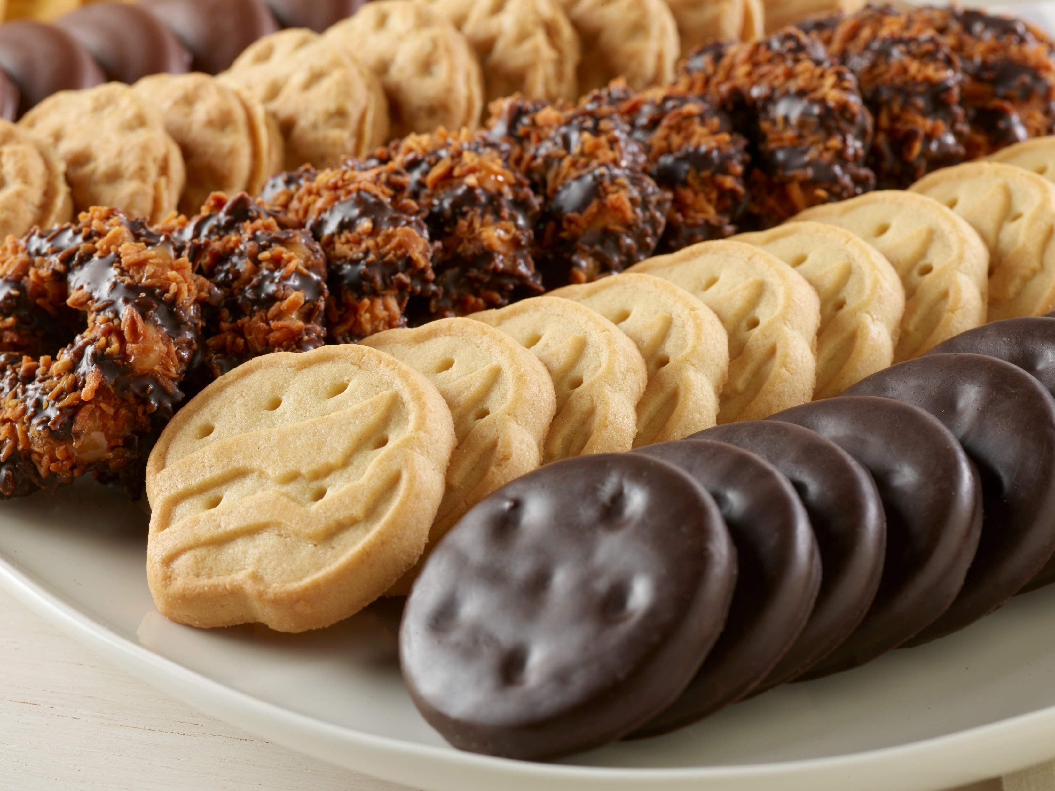
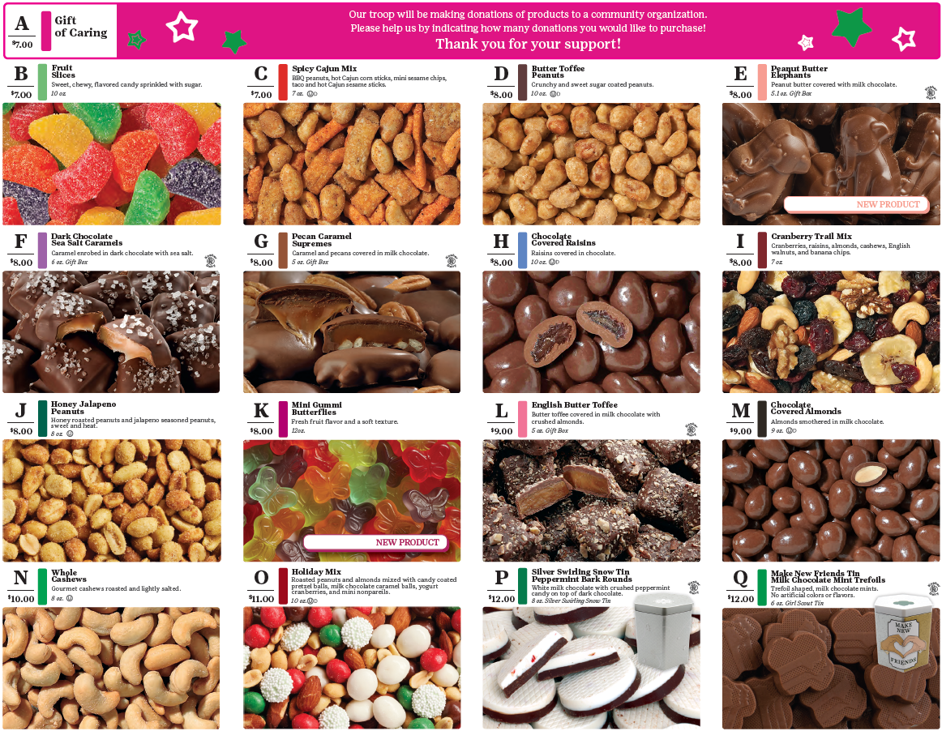
Products
Notes:
GSGLA partners with Little Brownie Bakers to produce our iconic Girl Scout cookies. We offer 9 cookies online and in person.
Girl Scours can sell cookies in person, at booths, or online with our Digital Cookie platform.
GSGLA’s Fall Product Program partners are Trophy Nut Co. and M2 Media. Girl Scouts have the opportunity to sell nuts, candy, magazines, tumblers, candles and personalized products through in-person or online avenues. Customers can choose whether they want the products shipped directly to them at an additional cost, or if they would like for the Girl Scout to deliver them.

Slide 8
Gift of Caring + Cookies for the Community
The Gift of Caring (GOC) and Cookies for the Community (C4C) programs allow customers to donate to the armed forces, first responders, food bank, or other community partners.
Donations are tax-deductible
Consider GOC/C4C as a variety.
Great for out-of-area customers.
No products are exchanged when participating in the GOC/C4C program.
Notes:
The Gift of Caring (GOC) and Cookies for the Community (C4C) programs allow a package of cookies or can of nuts to be donated to the armed forces, first responders, and/or food bank or other community partners.
Donations are tax-deductible; receipts can be printed from the GSGLA website.
Consider GOC/C4C as a variety. It is sugar-free, fat-free, gluten-free, calorie-free, and guilt-free.
Through our online sales tools, out-of-area customers can support the Juliette's goals without incurring the cost of shipping product.
No products are exchanged when participating in the GOC/C4C program. The money is noted as a GOC/C4C donation, and GSGLA will send the products to the GOC/C4C community partners.

Slide 9
Proceeds + recognitions
Juliettes earn recognitions and proceeds.
Juliettes receive all individual girl rewards.
Proceeds:
  $1/ package of cookies sold
  25% of nut products
  20% of magazine subscriptions and other online items.
Juliette proceeds are retained by the service unit
Funds may not be earmarked for an individual Girl Scout based on her sales.
The funds may be spent on Girl Scout program activities, including:
  Girl Scout Shop
  Membership registration
  Program and camp events
  Destination program.
Notes:
Juliettes earn recognitions and proceeds.
Juliettes receive all individual girl rewards.
Proceeds are $1/ package of cookies sold; 25% of nut products; and 20% of magazine subscriptions and other online items.
Juliette proceeds are retained by the service unit for safekeeping and distribution to all Juliettes in the service unit.
Funds earned from the product programs are never to follow a Girl Scout; therefore a girl cannot have individual benefit of those funds.
Funds may not be tracked at the girl level; no earmarking funds based on girl sales.
The funds may be spent on Girl Scout program activities, including in the Girl Scout Shop, for membership registration, or program and camp events. Proceeds may be applied to an approved “Destination” program.

Slide 10
When to sell Girl Scout products
Sales of Girl Scout products may only take place within the published dates of the program.
NO orders are allowed to be taken or sales made prior to the published product program start date.
NO sales are allowed after a product program ends.
Notes:
Sales of Girl Scout products may only take place within the published dates of the program.
NO orders are allowed to be taken or sales made prior to the published product program start date. Girl Scouts are allowed to announce in advance to potential customers that the sale is starting soon, however, cannot accept orders until the start date.
NO sales are allowed after a product program ends. Selling cookies after the sale end date is prohibited as the applicable sales permits have expired.

Slide 11
Internet marketing
Girl Scouts may use age-appropriate Internet tools.
Online social networking sites are allowed:
  Fall Product Program: Private social media account to people the girl personally knows.
  Cookie Program: Posts on a public social media account are permitted
M2OS
Digital Cookie
Follow all safety guidelines.
Girl Scouts may NOT engage in selling on the Internet.
Notes:
Girl Scouts may use age-appropriate Internet tools to promote their cookie business. Product delivery and payment must be done in person, except when transactions are done through GSGLA-sponsored online platforms (see below).
Online social networking sites (such as Facebook and Twitter) are a great place for teens, 13 and older with parent permission, to promote and ask for cookie orders. With permission and adult supervision, younger girls can use their parent's internet tools.
Fall Product Program: Posts must be from a private social media account to people the Girl Scout personally knows. Viral posts are not permitted.
Cookie Program: Posts on a public social media account are permitted
M2OS—the online sales platform that girls use to sell nut products for shipment, delivery, and Gift of Caring.
Digital Cookie—the platform that GSGLA offers for girls to sell cookies online for delivery, shipment, and Cookies for the Community.
Be sure to follow Computer/Online Use Guidelines in Safety Activity Checkpoints. For additional resources, visit GSUSA’s Basic Online Guidance for Product Sales at www.girlscouts.org.
Girl Scouts or their family/friends may NOT engage in selling on the Internet except for the approved platforms mentioned earlier. Selling Girl Scout cookies on eBay, Craigslist, Amazon, Facebook Marketplace, or any other online resale site is NOT allowed.

Slide 12
Taking orders + receiving products
Fall Product: Use the order card to take orders and place your order through your Juliette Advisor for pick-up.
Cookies: Order cookies through your Juliette Advisor.
Notes:
Fall Product: Use the order card to take orders and place your order through your Juliette Advisor for pick-up.
Cookies: Order cookies (Starting Inventory Order) through your Juliette Advisor. You will have cookies on hand to sell to customers when the sale starts.

Slide 13
Cookie Program
Starting Inventory Order.
Girls can use an order card to track sales and customer information.
Families are not limited to the one-time inventory allotment.
Families turn in funds to the Juliette Advisor for cookies as they sell them.
Balance for all cookies is due shortly after the end of the sale.
Notes:
Girl Scouts will receive a Starting Inventory order from the Juliette Advisor.
Girl Scouts can use an order card to track sales or customer contact information.
Families are not limited to the one-time inventory allotment; they should pick up additional inventory as needed throughout the sale--just check with your Juliette Advisor.
Families turn in funds to the Juliette Advisor for cookies as they sell them. Cookies are not pre-paid.
Balance for all cookies is due shortly after the end of the sale.

Slide 14
Initial cookie inventory (SIO)
The Juliette will determine her sales goal.
The Juliette Advisor will submit the Starting Inventory Order (SIO) based upon the Juliette's goals.
The Juliette will be financially responsible for all cookies ordered and received.
The SIO is how the Juliette will get the majority (75%) of her cookie inventory.
GSGLA recommends a credit limit of approximately $300.
Notes:
The Juliette will determine the budget needed for the activities chosen to help determine her sales goal.
The Juliette Advisor will submit the Starting Inventory Order (SIO) based upon the Juliette's goals.
The Juliette will be financially responsible for all cookies ordered and received.
The SIO is how the Juliette will get the majority (75-80%) of her cookie inventory. Cookies are ordered in full case quantities (consisting of 12 boxes each). The Juliette Advisor can order additional cookies as needed.
GSGLA recommends that a Juliette not have more than 50 cookie packages for orders whose payments will be made upon delivery. This results in a credit limit of approximately $300. Juliette Advisors may place lower or higher credit limits if warranted. Juliettes must remit payment to the Juliette Advisor frequently

Slide 15
Product pick-up
Count each item before leaving your Juliette Advisor.
Always sign a receipt and take a copy.
Keep your product in a cool place, away from pets and strong odors.
Notes:
Your Juliette Advisor will notify you when the products are available to be picked up and from where.
Count each item before leaving your Juliette Advisor.
Always sign a receipt and take a copy. You are financially responsible for each package of cookies you sign for.
Keep your product in a cool place--do not store in the garage. (If cookies are damaged due to improper storage, you are still responsible for paying for them.)
Store products away from pets and strong odors, such as cigarette smoke and pungent foods.

Slide 16
Ways to Market Your Products
Ask friends and family.
Contact previous customers.
Try a Text-A-Thon.
Ask customers if they would like to purchase more before they are gone.
Remind customers that Girl Scout cookies and nut products are only available once a year.
Digital Cookie
M2OS
Door-to-door sales
Cookie/lemonade stand
Residential Walkabouts
Participate with other Girl Scouts at a (cookie) booth.
Notes:
There are many ways for Girl Scouts to market their products
Start by asking friends and family to buy Girl Scout Cookies/Fall Product or contribute to Gift of Caring/Cookies for the Community.
Girls should review last year’s order cards and contact those reliable customers.
Try a Text-A-Thon to let friends and family know “It’s Cookie/Fall Product Time” or “I have cookies/nuts NOW, no waiting!” Send a link to your storefront from M2OS or Digital Cookie.
As the sale nears an end, ask your customers if they would like to purchase more before they are gone.
Remind customers that Girl Scout cookies and nut products are only available once a year.
Expand your circle of customers by selling via the Digital Cookie platform , M2OS, residential door-to-door sales, setting up a lemonade or cookie stand at a private residence, and participating with other Girl Scouts at a (cookie) booth. Your Juliette Advisor can provide you with direction regarding these methods.
As you sell out of the product, go back to your Juliette Advisor for more.
Parents should be in communication with the Juliette Advisor regarding the girl’s current inventory.

Slide 17
Residential walkabouts
Juliettes may:
  Go door-to-door in residential areas only
  Sell in any residential neighborhood within GSGLA boundaries
Juliettes may not:
  Conduct a walkabouts in commercial or retail areas
  Condut door-to-door sales or walkabouts after dark
  Enter a customer’s home
  Approach customers in cars
  Never give their last name, address, or personal phone number while selling
Juliettes must:
  Always have an adult with them.
  Be familiar with the neighborhoods where they sell.
  Leave all pets at home while selling.
  Make sure cookies/nuts are protected from the elements (i.e, heat, rain, etc.).
Notes:
Juliettes are allowed to go door-to-door in residential areas only with cookies/nuts in a wagon or cart, anytime throughout the program. If a customer stops a Juliette while walking around your neighborhood, the Juliette can sell them the products; however, the Juliette is NOT permitted to stay in that spot and continue to sell. A walkabout means you are walking, not boothing.
Juliettes may sell in any residential neighborhood within GSGLA boundaries and must be familiar with the neighborhoods where they sell.
Walkabouts are NOT allowed in commercial or retail areas, such as strip malls, store fronts/sidewalks, shopping centers, parking lots, etc.
Juliettes must always have an adult with them.
Juliettes should leave all pets at home while selling, unless a working animal companion is necessary.
NO door-to-door sales or walkabouts after dark.
Juliettes should never enter a customer’s home. Stay outside the home where you can be seen from the street.
Juliettes should never approach customers in cars.
Juliettes should never give their last name, address, or personal phone number while selling.
If you are conducting a walkabout or lemonade stand, make sure cookies/nuts are protected from the elements (i.e, heat, rain, etc.). Consider using a rolling cooler to keep products from melting.

Slide 18
Lemonade/Cookie stands
A booth set up on the property where the Juliette or a someone she knows resides.
Both an adult and the Juliette must be present at all times.
Products and money must never be left unattended.
Cannot be set up on the street corner, sidewalk, street medians, or outside of fencing or walls.
Keep products protected from the elements.
Juliettes may not post the address of their cookie stand.
Notes:
A lemonade or cookie stand is a booth set up on the property where the Juliette or a someone she knows resides as their city, homeowner's association, and/or property management permits
Both an adult and the Juliette must be present at all times.
Products and money must never to be left unattended.
Juliettes who reside in an apartment, gated community or any other property requiring management approval, must obtain management approval prior to setting up.
Apartment, condominium, and townhome set-up must be in a common area inside the complex, not on the street or sidewalk or outside of fencing or walls.
Cannot be set up on the street corner, sidewalk, street medians, or outside of fencing or walls.
Any signage must follow city, property management, and/or homeowner association signage rules.
Adhere to local city/government ordinances.
Keep products shaded from the elements (i.e., heat, rain, etc.). Consider using a rolling cooler to keep cookies from melting (for walkabouts, too).
Juliettes may not post the address of their lemonade stand on publicly viewed web sites, such as NextDoor.

Slide 19
Workplace selling
Taking orders or selling products at a workplace.
Request permission to sell to employees of the business.
Girl Scouts can:
  Make a quick “sales pitch” at a staff meeting or leave an order card with a note from the Juliette in a location visible to employees only.
  Sell cookies to the employees of these locations.
  Girl Scouts are to sell the products, not adults.
  Set a date to pick up the order card and deliver the products.
Cookies/nuts can never be displayed on the counter for patrons/customers.
Notes:
Workplace selling is the practice of taking orders or selling products at a workplace (including a parent or caregiver’s workplace).
Juliettes must contact business owners or managers to request permission to sell to employees of the business.
With management approval, Girl Scouts can:
Make a quick “sales pitch” at a staff meeting or leave an order card with a note from the Juliette in a location visible to employees (not walk-in customers). Do not list the Juliette's last name or phone number on the order card or note.
Sell cookies to the employees of these locations (office door-to-door or cubicle-to-cubicle); however, you cannot sell directly to the establishment’s customers (this would be a special booth).
Remember, girls are to sell the products, not adults.
Set a date to pick up the order card and deliver the products so customers know what to expect.
A parent may have cookies/nuts to sell at their place of work, but any displays must include a message from the Juliette and must not be visible to the business’ customers.
Setting up a table display in front of a small business is considered a special booth and needs advanced approval. Consult with your Juliette Advisor to obtain the necessary approval (only available during the Cookie Program).
Cookies/nuts can never be displayed on the counter for patrons/customers even if the family owns the business. Cookies can only be sold to the establishment's employees -- not the customers/patrons.

Slide 20
Online selling
Girl Scouts may only sell cookies and nuts through GSGLA sponsored online platforms.
Orders and payments are taken through M2OS and Digital Cookie.
Orders may be for girl delivery, shipping, or a donation program.
Check Digital Cookie regularly for new orders.
Girl Scout products may not be sold on resale websites.
Notes:
For online selling, girls may only sell cookies and nuts through GSGLA sponsored online platforms (M2OS and Digital Cookie)
Orders and payments are taken through M2OS (Fall) and Digital Cookie (Cookie Program)
Orders may be for girl delivery, shipping, or a donation program (GOC or C4C)
Check Digital Cookie regularly for new orders
Girl Scout products may not be sold on resale websites, such as Craigslist, Amazon, Facebook Marketplace, etc.

Slide 21
Cookie booths
Cookie booths are stations set up at a store or other business.
We are guests and need to be on our BEST behavior.
Booths may only be conducted during the scheduled dates.
The booth locations are pre-authorized by GSGLA and scheduled by the Juliette Advisor.
Seek required approval for any special booth locations outside of what is offered.
Only registered Girl Scouts can booth.
Juliettes can share a booth site with another Juliette or other Girl Scout troops.
Each booth requires both girls and adults to be present.
Two adults are required to be present at all times, at least one of whom is female. One adult must be a registered member of GSUSA.
One Girl / One Parent Boothing (available for Cadettes and older ONLY).
Notes:
Cookie booths are stations, usually a table and chair, where Girl Scouts sell cookies, most often set up at a storefront or other business.
As guests in front of a business, we need to be on our BEST behavior.
Booths may only be conducted during the Cookie Program during the scheduled dates.
The booth locations are pre-authorized by GSGLA. All boothing must be arranged through the Juliette Advisor..
Consult with your Juliette Advisor to seek required approval for any special booth locations outside of what is offered.
Only registered Girl Scouts can booth; therefore, siblings and friends are not allowed.
Juliettes can share a booth site with another Juliette or other Girl Scout troops.
Each booth requires both girls and adults to be present. Parents are asked to help at each booth location.
Two adults are required to be present at all times, at least one of whom is female. One adult must be a registered member of GSUSA.
One Girl / One Parent Boothing (available for Cadettes and older ONLY). Although boothing is primarily a troop activity, GSGLA recognizes that some girls have high reaching goals or have additional product to sell towards the end of the sale and may want the opportunity to booth independently to meet their goals. In this case:
Troops are given the opportunity to participate in booths first.
Booths must be scheduled by the Juliette Advisor on behalf of the Juliette. There are specific dates that this is available.

Slide 22
Special booths
Special booths are a unique, one-time opportunity.
Examples: churches, schools, sporting events, and small businesses.
Special booth requests require written pre-approval from your Juliette Advisor.
Notes:
Special booths are a unique, one-time opportunity to booth at a location that has not been approved yet.
Examples of a special booth include: churches, schools, sporting events, and small businesses.
Special booth requests require written pre-approval from your Juliette Advisor and the Service Unit Cookie Program Chair. Approval may take longer if the booth site is out of the service unit’s area.
Consult with your Juliette Advisor if you want to do a special booth.

Slide 23
Before, during, + after a booth
Arrive on time and end on time.
Set up your booth to appeal to customers.
Be polite and have your sales pitch ready for interested shoppers.
Ensure the cookies are right next to you and never out of your sight.
A cash box MUST always be in your possession.
Do not eat anywhere near the booth site.
Have a great attitude, smile, and say thank you even if a customer does not buy.
Do not block the entrance.
All conflicts must be resolved quietly, peacefully, and out of ear shot from the girls.
Cell phones devices should not be used during your boothing shift for personal use.
Clean up ALL trash and take it with you to dispose of.
If someone takes money or cookies from your booth, do not attempt to physically recover the stolen items.
Notes:
Before, during and after a booth:
Arrive on time and end on time. Respect the next scheduled troop and prepare to turn over the site on time.
Set up your booth to appeal to customers. Coordinate with the Juliette Advisor about who will bring the equipment and supplies. Use a covered table to display your cookies. Do not affix anything to the property of where the booth is held.
Be polite and have your sales pitch ready for interested shoppers.
Ensure the cookies are right next to you and never out of your sight.
A cash box MUST always be in your possession. Do not leave cash visible to customers. Using a fanny pack, money belt, or cross body purse are great options for holding cash. Have change available, and never ask the host business for change.
Do not eat anywhere near the booth site, and adults should not smoke anywhere visible to Juliettes or customers.
Arrive at a booth location with a great attitude, smile, and say thank you even if a customer does not buy.
Do not block the entrance; approach customers only as they are leaving the business.
All conflicts must be resolved quietly, peacefully, and out of ear shot from the girls.
Cell phones or other electronic devices should not be used during your boothing shift for personal use.
Clean up ALL trash and take it with you to dispose of. Do not leave empty boxes or trash at the booth site.
If someone takes money or cookies from your booth, do not attempt to physically recover the stolen items.
Instead, get a good description of the offender(s), call 911, and alert local security and your Juliette Advisor.

Slide 24
So. Calif. council border agreement
Selling outside of the GSGLA council region is allowed on an exception basis.
Family: Family and the family’s immediate neighbors.
Friends: Close friends.
Workplace: Parent or caregiver’s workplace only.
Cookie stands, walkabouts, and boothing of any kind: NEVER allowed outside of GSGLA borders.
Notes:
Selling outside of the GSGLA council region (aka "cross-border selling") is allowed during GSGLA product program dates on an exception basis.
A map of GSGLA boundaries can be found at girlscoutsla.org.
Family: Juliettes can sell to family and to the family’s immediate neighbors across the GSGLA border.
Friends: Close friends are okay.
Workplace: In the parent or caregiver’s workplace only (to work colleagues only, not to their customers). No friend’s nor extended family’s workplaces are allowed.
Cookie stands, walkabouts, and boothing of any kind: NEVER allowed outside of GSGLA borders.

Slide 25
Money handling
Use the Take a Payment feature in Digital Cookie to accept credit card payments.
Count the money collected
Only take checks from people you know and trust.
Checks are to be made payable to your Service Unit.
Parents may not accept payments from customers via payment apps.
Do not accept bills larger than $20.
Turn in money promptly and frequently.
Families are responsible for any lost, stolen or counterfeit money.
Notes:
Juliettes are encouraged to use the Take a Payment feature in Digital Cookie to accept credit card payments.
When collecting money from customers for individual sales, make sure to count the money and only take checks from people you know and trust.
Checks received are to be made payable to your Service Unit. Ask your Juliette Advisor for the appropriate and correct name.
Accept only preprinted checks with issuer’s address. Write the issuer’s phone number and driver’s license number on the face of check.
Note the Juliette's first name and last initial in the memo line of the check.
GSGLA cautions against accepting out of state checks.
Parents may not accept payments from customers via Paypal/Venmo/Zelle, or similar payment apps.
Do not accept bills larger than $20.
Turn in money to your Juliette Advisor promptly and frequently. Make sure to get a receipt from your Juliette Advisor for money you turn in.
Families are responsible for any lost, stolen or counterfeit money.

Slide 26
Exchanges + returns
Damaged items will be exchanged for the same variety.
Fall nut products may not be exchanged or returned.
Check whether cookie exchanges and returns are allowed.
Exchange or return undamaged, factory-sealed cookies within the timeframes and guidelines provided.
Any cookies not returned by the designated date will be the financial responsibility of the Juliette's family.
Notes:
Damaged items (compromised or crushed can/box) will be exchanged for the same variety. Melted chocolate is not considered damaged, so be sure to store products carefully.
Fall nut products may not be exchanged or returned.
Check with your Juliette Advisor to determine whether exchanges and returns are allowed prior to placing and picking up your cookie order.
It's the Juliette's family responsibility to exchange or return undamaged, factory-sealed cookies to the Juliette Advisor within the timeframes and guidelines provided by the Juliette Advisor.
Any cookies not returned to the Juliette Advisor by the designated date will be the financial responsibility of the Juliette's family. It's about teamwork and communication.

Slide 27
Safety tips
Follow all GSGLA published safety guidelines:
Show you are a Girl Scout
Buddy up
Be streetwise
Partner with adults
Plan ahead
Do not enter
Sell in the daytime
Protect Privacy
Be safe on the road
Be net wise
Notes:
All girls who participate in the Girl Scout Product Programs use 10 Basic Safety Guidelines and follow all GSGLA published safety guidelines.
Show you are a Girl Scout – wear a uniform or membership pin
Buddy up – it’s more fun with a friend
Be streetwise – know the neighborhood where you are selling
Partner with adults – girls must be supervised by adults at all times
Plan ahead – safeguard funds
Do not enter – do not enter customers’ homes or approach cars
Sell in the daytime – no sales after dark
Protect Privacy – never give out a girl’s last name or contact information
Be safe on the road – follow all pedestrian rules
Be net wise – follow online safety guidelines

Slide 28
Girl code of conduct
Juliettes agree to:
Adhere to the principles of the Girl Scout Promise and Law and follow all GSGLA guidelines.
Follow the rules to help make sure program activities are safe, fun and successful.
Not sell cookies prior to the start of the product program.
Wear appropriate Girl Scout attire and dress neatly and appropriately for the weather.
Treat other people, themselves, property and equipment with respect.
Listen carefully to all instructions.
Not run or demonstrate any physical activity that could place them in harm. They will not participate in any roughhousing, running, loud voices, or inappropriate language.
Never give out their last name, address, or telephone number to customers.
Notes:
Juliettes agree to:
Adhere to the principles of the Girl Scout Promise and Law and follow all GSGLA guidelines.
Follow the rules to help make sure program activities are safe, fun and successful.
Not sell cookies prior to the start of the product program.
Wear appropriate Girl Scout attire and dress neatly and appropriately for the weather.
Treat other people, themselves, property and equipment with respect, i.e. leaving no trash behind.
Listen carefully to all instructions and appropriately respond to all directions given by the Girl Scout Juliette Advisor or the adult in charge.
Not run or demonstrate any physical activity that could place them in harm. They will not participate in any roughhousing, running, loud voices, or inappropriate language.
Never give out their last name, address, or telephone number to customers. Instead, they will refer the customer to the adult volunteer.

Slide 29
Adult code of conduct
Adults agree to:
Adhere to the principles of the Girl Scout Promise and Law and follow the GSGLA guidelines.
Be respectful of the Service Unit Juliette Advisor or adult in charge.
Be responsible for all money collected.
Be financially responsible for all product received
Pay for all product by the due date set by the Juliette Advisor.
Treat other people, themselves, property and equipment with respect.
Remove all cardboard boxes and trash from boothing sites.
Make sure their daughter does not take orders or sell cookies prior to the start of any product program
Not take siblings and friends to a cookie booth.
Not violate GSGLA or National Girl Scout policies, create discord, or damage or misuse property.
Not demonstrate any violence of any kind, including inappropriate conduct, profanity or verbal abuse.
Not be under the influence of or hold possession of illegal substances during any Girl Scout activities. Firearms or weaponry of any kind are not allowed.
Not smoke in the presence of girls during Girl Scout activities.
Support the goals established by their daughter and the Juliette Advisor.
Assist, but not sell Girl Scout products.
Notes:
Adults agree to:
Adhere to the principles of the Girl Scout Promise and Law and follow the GSGLA guidelines.
Be respectful of the Service Unit Juliette Advisor or adult in charge.
Be responsible for all money collected. Misuse of Council and/or a Juliette's funds will not be tolerated.
Be financially responsible for all product received, and all product must be paid for by the due date set by the Juliette Advisor.
Treat other people, themselves, property and equipment with respect.
Remove all cardboard boxes and trash from boothing sites and dispose of them at their home.
Make sure their daughter does not take orders or sell cookies prior to the start of any product program
Not take siblings and friends to a cookie booth.
Not violate GSGLA or National Girl Scout policies, create discord, or damage or misuse property.
Not demonstrate any violence of any kind, including inappropriate conduct, profanity or verbal abuse.
Not be under the influence of or hold possession of illegal substances during any Girl Scout activities. Firearms or weaponry of any kind are not allowed.
Not smoke in the presence of girls during Girl Scout activities.
Support the goals established by their daughter and the Juliette Advisor.
Assist, but not sell Girl Scout products. This is the girl's business to operate.

Slide 30
Consequences
If Juliettes are not selling in accordance with the established rules and codes of conduct, they can have one or more of the following consequences enforced:
Removal of the highest reward level earned
Reduction in the Juliette's proceeds
Reduction in packages sold by the Juliette
Forfeiture of the Juliette's proceeds/rewards
No future boothing
Notes:
Throughout this training, you have been provided with many things you can and cannot do.
All of these rules and codes of conduct have been put into place for many reasons. Reasons include, although are not limited to: safety, fairness to all girls, and GSUSA/GSGLA policies and procedures.
The rules and codes of conduct put in place are to ensure all girls can run a successful, fair, and fun Girl Scout product business.
In the event a consequence needs to be applied, the decision on which consequence to impose will be decided by the GSGLA Product Programs Manager and/or Sr. Director of Retail Sales and Product Programs. The severity of the consequence imposed will be based on the rules broken, impact to others, safety, and if one or multiple infractions were made.
Possible consequences include:
Removal of the highest reward level earned
Reduction in the Juliette's proceeds
Reduction in packages sold by the Juliette
Forfeiture of the Juliette's proceeds/rewards
No future boothing

Slide 31
Most common examples of rules not complied with:
Taking orders or selling before the start date of a product program
Selling products for the incorrect price
Selling products outside of authorized areas.
Conducting a booth without submitting and receiving a special request approval.
Girl Scouts selling or delivering products alone
Boothing with the incorrect girl/adult ratio
Inappropriate behavior at a booth location
Failure to pay for product
Notes:
Most common examples of rules or regulations not complied with:
NOTE: This is NOT an exhaustive list, only a few examples.
Taking orders or selling before the start date of a product program
Selling products for the incorrect price
Selling products outside of authorized areas. For example: selling on a sidewalk or street corner, conducting a walkabout in a commercial/business area, selling in front of a school, boothing or setting up a lemonade stand outside of GSGLA borders, adults selling without a girl present.
Conducting a booth without submitting and receiving a special request approval.
Girl Scouts selling or delivering products alone
Boothing with the incorrect girl/adult ratio or inappropriate behavior at a booth location
Failure to pay for product and submit money as stated by GSGLA and/or your Juliette Advisor.
Following all of the rules and guidelines will ensure fairness to all Girl Scouts during the product programs.

Slide 32

Thank You
Product Program Team
www.girlscoutsla.org
213-213-0123
Notes:
Good luck and have fun with your product programs! Thank you for watching this training.

