Slide 1
2025 Cookie Program Girl Scout and Family Training
Notes:
Thank you for joining us for the 2025 Cookie Program Family Training. We are hope that you and your Girl Scout are excited about the upcoming Cookie Season. This training will cover the program basics and help you to get started.

Slide 2
Mascot & Theme
Pearl the Panda
Notes:
Our mascot for the 2024 Cookie Program is Lucy the Axolotl and the theme is Own Your Magic!

Slide 3
5 Skills
Goal Setting
Decision Making
Money Management
People Skills
Business Ethics
Notes:
When girls participate in the Cookie Program, they learn five valuable life skills: goal setting, decision making, money management, people skills and business ethics.
Goal Setting: Girls start by setting a personal cookie sales goal. Then with her troop, the girls work together to set a troop goal. Once the girls set their collaborative goal, they can begin to work with their family and fellow troop members to develop a plan to achieve them.
Why is this important? When girls set goals it is the first step toward success in school, jobs, and in life.
Decision Making: Girls will decide how they will market their cookie program and when and where they will sell cookies. Girls will work together as a troop to make the ultimate decision on how they spend their earnings. (Troop activities, community service projects, trainings, travel, etc.)
Why is this important? Throughout their life girls make daily decisions, big and small, and when girls practice and implement decision making, they begin to see the impact of their decisions. They develop a strong process of making good decisions. They begin to see themselves as a confident leader capable of making decisions for themselves, and to make the world a better place.
Money Management: Girls will have the opportunity to work on developing a budget. After they have set their sales goal, they will be able to determine a budget and manage their funds as they manage their revenue. Girls will take sales orders, count money, and deliver money to their troop volunteers.
Why is this important? Learning to manage their cookie sale funds will also help them understand managing their personal finances. Girls develop a better understanding of managing their allowance and a future paycheck because they learn by doing during the cookie program.
People Skills: Girls develop people skills by talking to customers, learning to become good listeners, and building relationships with their sister Girl Scouts as they work as a team.
Why is this important? As girls deliver their sales pitch and interact with customers, their self-confidence flourishes. Girls are ready and able to answer questions about their goals, their favorite cookie, and what they plan to do with their earnings. People skills help girls in school, communicating with their friends, in team sports, group projects, and future job success.
Business Ethics: During the Girl Scout Cookie Program, girls practice sound business ethics, by being responsible for their cookie inventory, cookie payments to their troop, and their commitment to their customers.
Why is this important? As Cookie Entrepreneurs girls are responsible for managing their own cookie business, while practicing sound business ethics and working cohesively as a team. Future employers want to hire ethical employees with refined life skills.

Slide 4
What Can a Cookie Do?
All cookie proceeds stay in Greater Los Angeles to fund and support Girl Scouts, via:
High quality Girl Scout programs
Volunteer training & resources
Property repair & maintenance
Council operations
Notes:
Girl Scout Cookie proceeds stay local to:
Cover the cost of running the Girl Scout Cookie Program, including the costs of cookies, materials, and logistics
Fund Take Action projects for the community and amazing girl-led adventures for troops
Provide Girl Scout programs like STEM, the outdoors, life skills, and entrepreneurship, as well as camps, leadership training, and more!
Girl and volunteer support, including financial assistance for underserved girls and volunteer training and resources.
Troop earnings and rewards, which girls use for activities like travel, camp, and community service projects.
The Girl Scout Cookie Program is the largest girl-led entrepreneurial program in the world

Slide 5
How does the troop spend its proceeds?
Troops earn $1 - $1.10 per package of cookies sold
Program activities like field trips and travel
Troop meeting supplies
Take Action projects
Notes:
The Girl Scouts budget and plan how to spend their cookie proceeds. Parents/caregiver can work with their daughters on goal-setting and creative ideas for selling within the guidance provided to achieve their personal and troop goals.
Girl Scouts may spend proceeds on program activities like trips and fun events or virtual hands-on activities that they do together, troop meetings and supplies, and Take Action projects and community service to help make the world a better place.
The troop proceeds are used to provide program to all of the girls in the troop equally, no matter how a Girl Scout participates in the Cookie Program

Slide 6
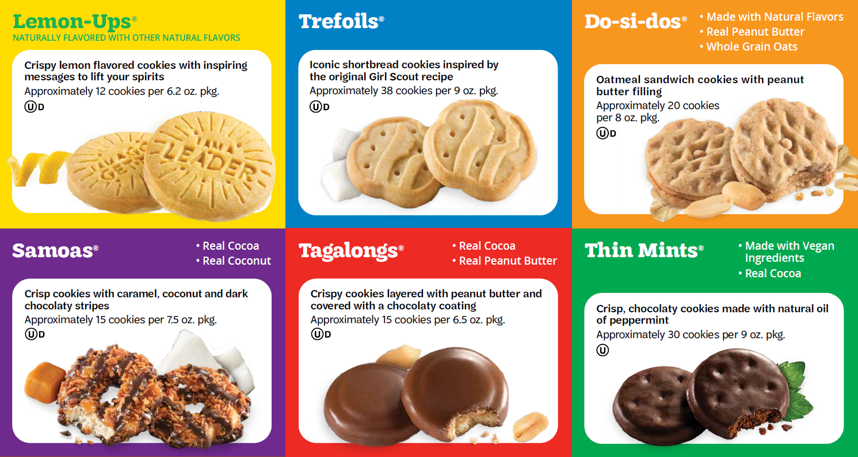
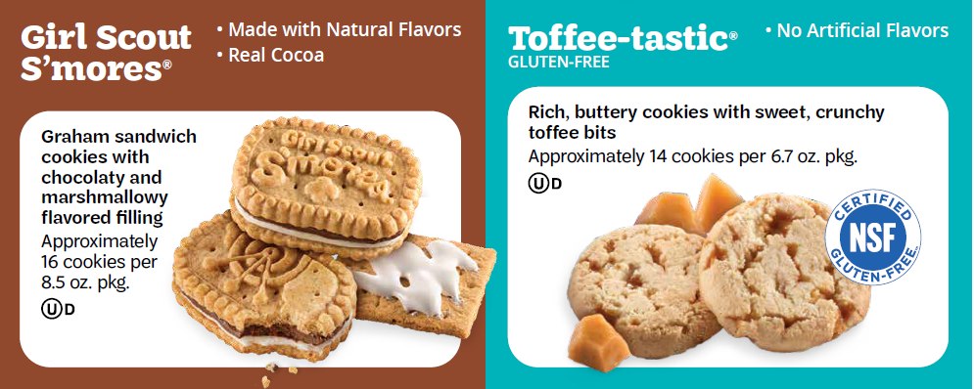
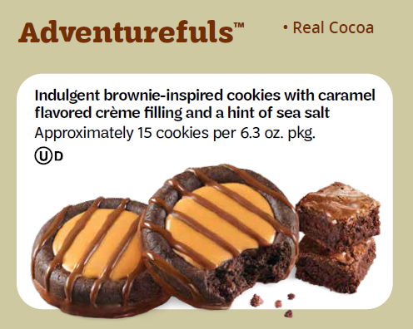
2025 Cookie Lineup
Notes:
Girl Scouts of Greater Los Angeles partners with Little Brownie Bakers to deliver our iconic Girl Scout Cookies.
This year there are 9 cookies in our line-up. Our core six varieties are $6/package and our specialty cookies (Toffee-Tastic & S’mores) are now $7/package.
This is the last year that S’mores will be available, so be sure to tell your customers to stock up on this yummy flavor.

Slide 7
Cookies for the Community
Our 10th variety of cookies!
A “virtual” package is sold for $6
GSGLA donates cookies to one of our C4C partners
All girls should try to become comfortable offering C4C to their customers.
Girls can earn special C4C Rewards.
Notes:
Cookies for the Community is our beloved and popular donation program.
Through Cookies for the Community, customers purchase virtual packages of cookies that will be donated to our Cookies for the Community partners, such as the Food Bank, USO, Blue Star Mothers, and Operation Gratitude. We also make donations to other community organizations as needs arise.
Customers can feel good about supporting the girls and the community with their tax-deductible donations, and girls earn proceeds and rewards for these cookies. Girls should ask each customer if they would like to support the Cookies for the Community program.

Slide 8
Cookie Team
Cookie Chair
Distribution Chair
Treasurer
Boothing Chair
Rewards Chair
Notes:
There is a team of volunteers in your troop ready to support your Girl Scout and her family.
The Troop Cookie Chair is the main person in charge of the cookie program. She/he will take the girls’ orders and place them in our inventory system called eBudde.
The Distribution Chair will organize the pick-up of cookies.
The Troop Treasurer collects money from families, receipts it, and deposits it to the troop bank account.
The Boothing Chair will coordinate boothing opportunities for the girls who wish to participate in this sales avenue.
The Rewards Chair will receive the girls’ rewards after the program and distribute them.
Ask your troop leader if you can be part of the troop cookie team.

Slide 9
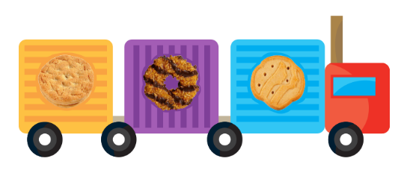
When will I get cookies?
Cookies will be available for pick up on January _____, at ________________________.
When we receive our delivery times, you will be able to sign up to pick up your initial order.
Notes:
Your Troop Cookie Chair will place a Starting Inventory Order for the troop so that the girls have cookies in hand on January 26. Be sure to let them know that your Girl Scout will be participating in the cookie program so that they can include her in the troop’s order. Share her goal with the troop cookie chair so she/he knows how many cookies to order on behalf of your Girl Scout. Troops may not place quotas or require girls to sell a certain amount of cookies,
Your Troop Cookie Chair will tell you when cookies will be available for pick up, around January 25. You’ll be able to sign up for a time to pick up your order from your Troop Cookie Chair. Be sure to get a signed receipt for the cookies from the troop and keep it for your records.
Girl Scouts may start delivering and selling cookies in person on Go Day, January 26.

Slide 10
COOKIE GO DAY IS JANUARY 26!
Notes:
The 2025 Cookie Program will run from January 14 – March 9. Order taking in Digital Cookie and on order cards begins on January 14. That means girls can sell through Digital Cookie and take orders almost two weeks prior to Go Day!

Slide 11
Selling Cookies
Girl Scouts and adults must follow safety guidelines at all times while selling cookies
Girl Scouts may sell cookies via email, text, social media and Digital Cookie
No resale sites like Craigslist, eBay, Facebook Marketplace or Amazon
No paid ads
Door-to-Door / Residential Walkabouts
Community parks allowed, provided local ordinances permit
Residential Cookie Stands
At the property where the girl or someone she knows resides
Starting on Go Day (Jan. 26)
Booths
Storefront or drive-through
Adult ratios must be followed
Workplace (virtual or in person)
To employees only, not the business’ customers
Girl must post a message to employees
Businesses cannot sell cookies, i.e. no cookies on the counter visible to customers
Notes:
Girl Scouts must always be accompanied by an adult when selling or delivering cookies. Similarly, there must always be a Girl Scout present when cookies are being sold. Adults may not sell cookies without a Girl Scout present.
There are many options for girls to run their cookie business.
Online marketing helps girls reach large audiences to sell their cookies. Girl Scouts are encouraged to send emails to family and friends through Digital Cookie and may use social media platforms like Facebook and Twitter to promote their Digital Cookie link beginning on January 16.
Girl Scouts may not post on resale sites like Craigslist, eBay, Amazon, or Facebook Marketplace, not may they pay for social media ads.
Girl Scouts may go door to door on residential walkabouts in any neighborhood within GSGLA. If a customer isn’t home, they can leave a doorhanger with their Digital Cookie link or QR code, printable from Digital Cookie.
Girl Scouts may hold cookie stands to sell cookies at their own residences or that of someone they know, beginning January 28.
Booths are stands at businesses, where Girl Scouts sell cookies to the public. Boothing is a great way for Girl Scouts to work together to reach their goals. Troops must sign up for approved booth sites. At least two adults must be present at a booth, unless the Girl Scout is a Cadette or older, when she may booth alone with a parent or guardian during a certain timeframe. Talk to your Troop Cookie Chair about boothing opportunities.
Another way to market and sell cookies is through workplace sales to the employees of a work site. Your Girl Scout can make a pitch to the site’s employees on an app like Zoom or in person, take orders, and deliver cookies at a later date. As a parent or caregiver, you can take your daughter’s order card or cookies to your place of employment and sell cookies to your co-workers, only. For example, if you work at a doctor’s office, you can sell cookies to your co-workers in the break room, but not to the patients that come in to see the doctor. Please keep in mind, businesses cannot sell cookies even if the family owns the business.
Please make sure you are signed up for emails from GSGLA so that you will receive updates and detailed guidance on ways to sell cookies.

Slide 12
Digital Cookie
Digital Cookie opens January 14, 2025—almost two weeks before Go Day.
https://gsdigitalcookie.com/gsgla
Parents/caregivers receive a login email and set up their Girl Scout’s account.
Girl Scouts send emails to family, friends, and customers through the Digital Cookie platform.
Girl Scouts and parents/caregivers may post links to the girl’s storefront on social media – public posts allowed.
Customers purchase cookies with a credit card for girl delivery, direct shipment or C4C.
Girls are automatically credited for the packages sold and the troop receives payment to their troop bank account.
Notes:
Digital Cookie is the fun and safe way for girls to reach out to friends, family, and customers. They can send emails through the Digital Cookie platform or post on public social media sites. (No resale sites like eBay, Amazon, or Facebook Marketplace.)
Parents and Caregivers should keep an eye out for a login email in January, or they can go directly to the Digital Cookie site beginning January 16. The website is gsdigitalcookie.com/gsgla.
Girl Scouts get a personalized link to share with customers to purchase cookies for girl delivery, shipment, or donation to Cookies for the Community donations.
Payment happens at the time of the order. Credit for the packages and payment go directly to the troop bank account.
Parents and caregivers should check frequently for girl delivery orders. They can get inventory from the troop to fill orders—just let your Troop Cookie Chair know what you need.

Slide 13
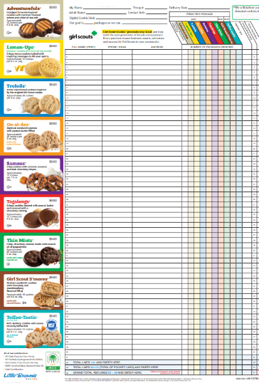
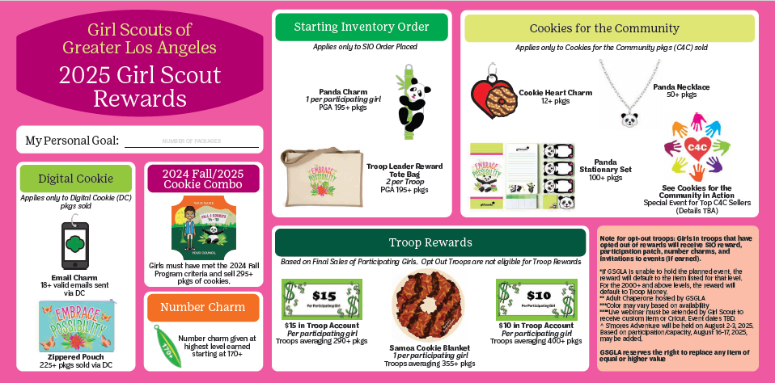
Order Card
Girls receive before Jan. 14.
Contains pricing, cookie types and nutrition facts.
Rewards displayed on the back
Notes:
Order cards provide a way for girls to track customer information. They also contain nutritional information about the cookies and have a list of the rewards on the back.

Slide 14
Handling Money and Cookies
Payment is collected only when cookies are delivered, except for Cookies for the Community and Digital Cookie orders.
Checks should be made payable to “GSGLA Troop _______.”
Girls should not accept bills larger than $20.
“Money Mondays” - Turn in any money collected in the prior week.
Parents/caregivers can use the Take a Payment feature in Digital Cookie to accept credit cards.
Parents/caregivers may use Paypal/Venmo or Zelle to pay the troop for cookies if the troop permits.
Customers may not use Paypal/Venmo/Zelle to pay individual Girl Scouts for cookies.
You will receive a receipt for every cookie and money transaction.
"Touch-base Tuesdays" – Communicate your inventory needs with the troop Cookie Team.
Let your troop Cookie Team know if you have too many cookies or need more cookies
Cookies should be stored indoors in a controlled environment away from pets and pests.
Notes:
Payment is collected only when cookies are delivered, except for Cookies for the Community and Digital Cookie orders. Girls should not have to pay for cookies before they are sold.
If the troop or family decides to collect checks, they should be made payable to “GSGLA Troop _______.”
Girls should not accept bills larger than $20. Families and troops are responsible for any lost, stolen, or counterfeit bills received.
“Money Mondays” - Turn in any money collected in the prior week.
Parents/caregivers are encouraged to use the Take a Payment feature in Digital Cookie to accept credit cards. The money gets credited directly to the troop and fees are paid by GSGLA.
Parents/caregivers may use Paypal/Venmo or Zelle to pay the troop for cookies if the troop accepts this type of payment.
Customers may not use Paypal/Venmo/Zelle or other payment apps to pay for cookies due to their service agreements and the risk to the troop.
You will receive a receipt for every cookie and money transaction. Keep your copy of the receipt for your records.
Touch-base Tuesdays – On a weekly basis, contact the Troop Cookie Team and advise if any additional cookies are needed or if the Girl Scout is having trouble selling her inventory. Communication is critical!
Cookies should be stored indoors in a controlled environment away from pets and pests. NEVER LEAVE COOKIES IN YOUR CAR. THEY WILL MELT if left in a car and could be stolen. Families are responsible for all cookies received.

Slide 15
Reward Options
Philanthropy: Girl Scouts can donate the value of their reward to the animal care and conservation initiatives at San Diego Zoo(specific levels only).
Events: At 550+, 1250+, 1500+, 2000+, 3000+
These levels also have reward items, which will be offered if the event cannot take place.
Program Credit: 550+, 1250+, 1500+, and 2000+
A GSGLA Gift Card will be issued
Can only be used internally (GSGLA) for:
Retail In-Store Purchases (not online)
Girl Annual Membership
GSGLA events
GSGLA specialty and resident camps
Destinations
Troop money: Girl Scouts can choose to convert program credit into money for the troop to be used to support all Girl Scouts in the troop.
Notes:
Girl Scouts earn credit towards rewards for all cookies sold, including in-person, online, and booths.
In addition to reward items, Girl Scouts can choose from other reward options for selling cookies.
Girl Scouts can be philanthropists by donating the value of their reward to the San Diego Zoo, home to two pandas.
Girl Scouts can also participate in fun events at certain levels. If a reward event cannot take place, the physical reward item for that level will be offered.
Program credit is a gift card that can be used within GSGLA for membership fees, retail store purchases, events, camps, and destinations.
Girl Scouts can also choose Troop Money instead of program credit and the money will be deposited directly to the troop account for all Girl Scouts in the troop to benefit from.

Slide 16
Notes:
There are so many reward items for Girl Scouts to earn through participation in the Cookie Program.
The axolotl participation patch is earned when a Girl Scout sells at least 24 packages of cookies. It has loops to add fun charms earned for sending 18 or more emails through Digital Cookie, if the troop places a significant Starting Inventory Order, or when Girl Scouts sell at least 12 packages of Cookies for the Community.
Girl Scouts also have the opportunity to earn additional funds and a pop up canopy for their troop.

Slide 17
Notes:
Some of the favorite must-earn rewards are the cookie program t-shirt and the Lucy and Axolotl plush.
Plus Girl Scouts can attend really fun events like the Smart Cookie Club at Hurricane Harbor, Disney Resort, or the S’mores Adventure weekend at Camp Lakota. Girl Scouts can also earn the opportunity to go on a scavenger hunt adventure with our CEO, Theresa Edy-Kiene or even a VIP experience at Universal Studios!

Slide 18
Rewards Order Delivery
The cookie rewards will arrive mid-to-late summer.
Rewards ordered after the program ends.
Supply chain and manufacturing timelines.
SUCPC will distribute rewards to troops.
Targeted by end of April:
Program credits will be provided separately.
All other monetary rewards will be directly deposited to troop/service unit bank accounts.
Notes:
The cookie rewards will be delivered to your Troop Cookie Chair mid-to-late summer.
Rewards are ordered after the program ends to ensure that we order the correct amount
We are affected by supply chain and manufacturing timelines.
Targeted by end of April:
Program credits will be provided separately.

Slide 19
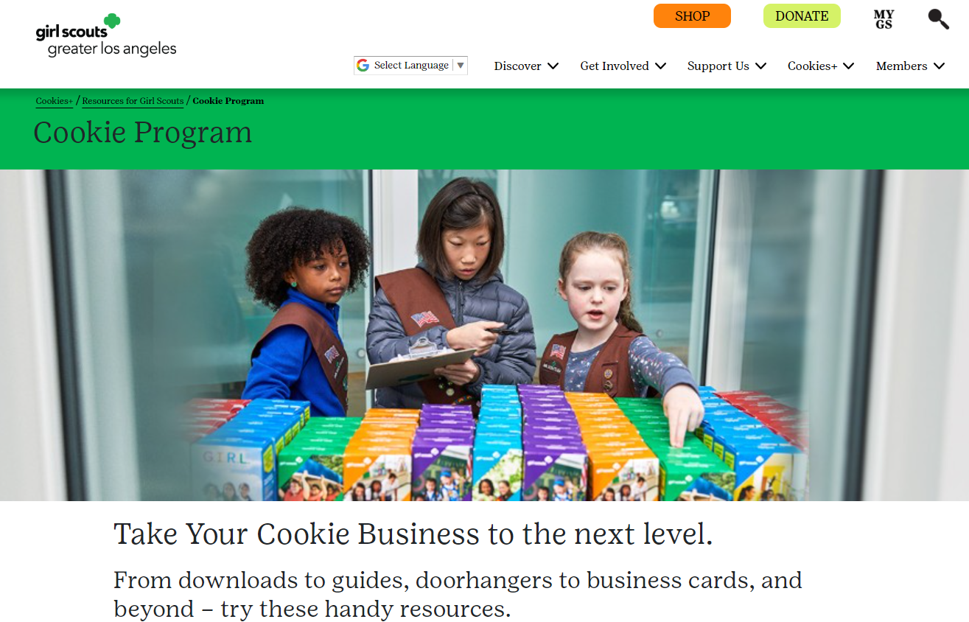
Resources
Cookie Family Guide
Quick Start Guide
Cookiegrams
Emails from your troop cookie chair
Cookies+ website (www.girlscoutsla.org/cookies)
Notes:
GSGLA has lots of resources to inform you about the cookie program.
We have several ways of communicating important cookie program information to families.
The Cookie Family Guide will be mailed to all households in January. Please review it carefully for details about the cookie program. The Quick Start Guide will be distributed to each girl from her troop. This has lots of information in a condensed format to inform you about the cookie program.
We will email cookiegrams to families with up-to-the-minute reminders and information. Please keep an eye out for these cookiegrams, as they may contain processes that are updated to follow changing health and safety guidelines.
Your Troop Cookie Chair will send you regular emails with reminders and updates.
The Cookies+ page on the GSGLA website has all of the information about the cookie program and marketing resources for your cookie entrepreneur to promote her cookie business.

Slide 20
Responsibilities
Girl Scouts & Adults:
Must follow all rules & guidelines listed on Parent/ Guardian Permission Form, the Parent Cookie Conduct Agreement, and in the Family Guide.
Must follow all troop deadlines regarding taking cookies and turning in money.
Must adhere to all guidelines regarding storing and selling cookies.
Must sign a receipt for any cookies taken from or money given to your Troop Cookie Team.
Are responsible for all cookies received.
Are responsible for all money due for cookies received.
Must communicate with your Troop Cookie Team.
Notes:
Each Girl Scouts and adult is responsible for following all of the guidelines listed in GSGLA publications. Please refer to the Parent/Guardian Permission form, the Parent Cookie Conduct Agreement, and the Family Guide for complete lists of responsibilities.
Some responsibilities include meeting troop due dates, storing and selling cookies in accordance with guidelines, receiving signed receipts every time you get cookies or turn in money. Families are responsible for all cookies received and all money due. Families must communicate with your troop cookie team regularly so that they know how your daughter’s cookie program is going.

Slide 21
Guidelines & Consequences
Troops, girls and parents must follow all of the guidelines of the Cookie Program. Possible consequences for failing to follow the guidelines include:
Loss of girl or troop rewards earned
Loss of troop proceeds
No future boothing
Most common infractions (some examples)
Taking orders before the program starts
Selling for the incorrect price
Selling in front of a school without approval
Boothing outside of GSGLA borders
Girls selling or delivering without an adult present
Incorrect girl/adult ratio at booth
Inappropriate behavior at booth
Not cleaning up after at booth site
Failure to pay for cookies
If you see someone not following the rules, do not approach them. Get their troop number and contact your troop or service unit cookie chair. Do not take pictures of girls!
Notes:
Read slide

Slide 22
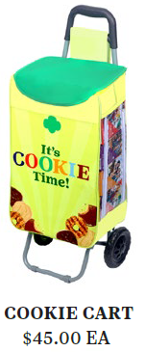
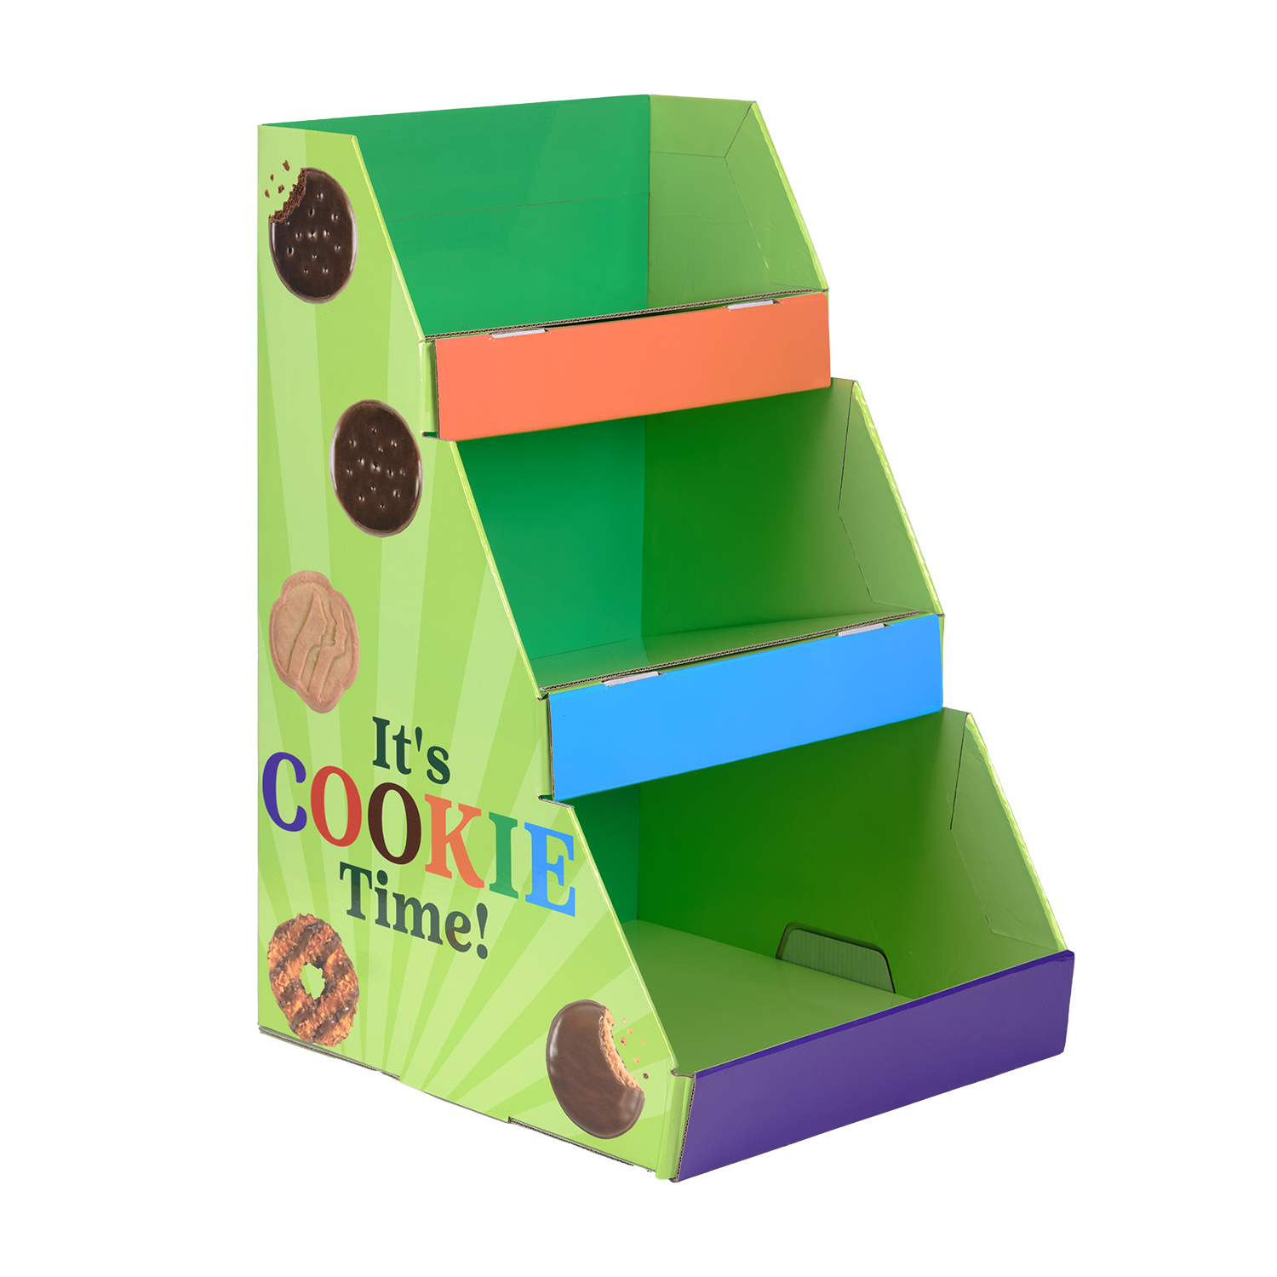
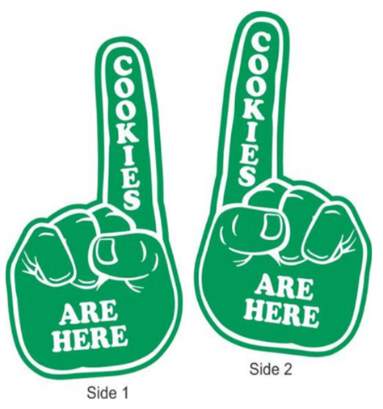
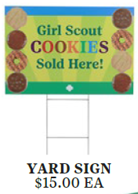
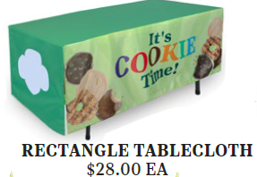
Cookie Retail Merchandise
Build brand awareness and boost sales!
These marketing tools can be found in our GSGLA stores in mid-November.
Notes:
Make the most of these colorful and cute marketing tools available in GSGLA stores starting in mid-November
Most items are GSGLA-own (we made them) and are NOT for purchase at GSUSA online.
These items do sell out fast and usually gone by end of January and there aren’t reorders on them.
IMPORTANT: The Cookie Cart is online at $49 and our price is $45. They have a shipping fee, plus a handling fee of $2.99 and taxes added to retail price. Way better to buy from us.

Slide 23
Commonly Asked Questions
Can I return cookies?
My friend owns a restaurant and said my daughter could sell in front of it. Is that ok?
Can my Girl Scout do a walkabout on a college campus?
What are the options to participate if my daughter’s troop does not want to sell cookies?
Can my Girl Scout sell cookies in front of a marijuana dispensary?
Can I post on Next Door?
Notes:
Can I return cookies?
Your troop may allow cookies to be returned by a certain date. Check with your Troop Cookie Chair as soon as you think you have too many cookies.
My friend owns a restaurant and said my daughter could sell in front of it. Is that ok?
You would have to get special permission from your troop cookie chair to do this as a one-time opportunity. If you wish to sell at this location more than one time, it has to be an approved booth that any Girl Scout can booth at,.
Can my Girl Scout do a walkabout on a college campus?
Walkabouts are in residential areas, only. While the student housing on a college campus may be viewed as residential, the fact that it’s on the campus makes it non-residential and therefore off-limits for a walkabout. Ask your Troop Cookie Chair if boothing is available on your nearby college campus.
What are the options to participate if my daughter’s troop does not want to sell cookies?
If your troop does not want to sell cookies, you can sign up to be the Troop Cookie Chair for your daughter. You would manage her cookie program as a parent/caregiver and as the troop volunteer.
Can my daughter sell cookies in front of a marijuana dispensary?
While GSGLA recognizes marijuana dispensaries and other adult-oriented businesses as legitimate, we do not feel that it’s appropriate for our Girl Scouts to booth in front of them. A good rule of thumb is that Girl Scouts may booth at businesses that they can be customers of.
Can I post on Next Door?
Girl Scouts may post their Digital Cookie link on NextDoor or similar apps, only within the immediate neighborhood where they reside.

Slide 24
Thank You
Product Programs Team
www.girlscoutsla.org/cookies
Notes:
Thank you for watching this training.
We are so excited to see the creative ways that girls will participate in the Cookie Program this year!

